Slide 1


Flag insincere data: How can I help you, Quora?
Shalin Gosalia

Slide 2






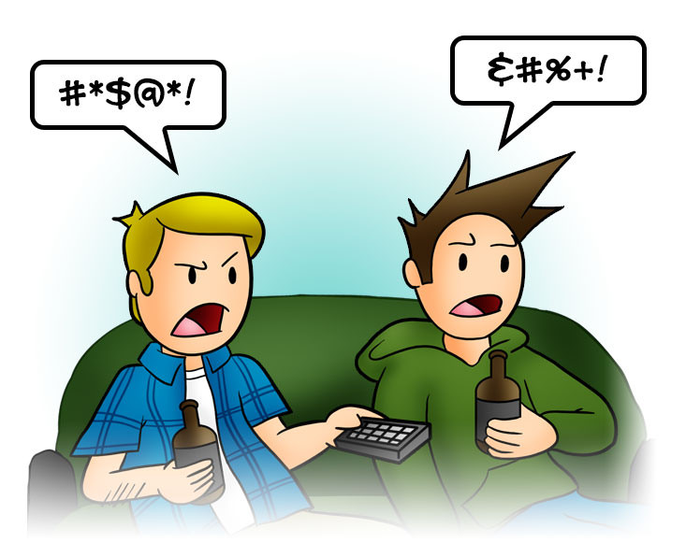

The Problem
Non neutral tone
Sexual content
Discriminatory content
Absurd assumptions
False information
Inflammatory content

Slide 3










Success Criteria
We take our ‘Be Nice, Be respectful’ policy seriously
Stakeholders
How do we classify posted questions on Quora as sincere vs insincere with high accuracy, so any future Quora posting can be moderated without any manual moderator intervention?

Slide 4










Steps Involved
Data Wrangling
Exploratory Data Analysis
Feature Engineering
Modeling and prediction
Model 1 Model 2 … Model 6
Classification
Data
Training: ~1048K questions
Test: ~ 376K questions
Cleansed Data
Combined dataset: 1024K questions
Data (Training data development)
Training: ~717K questions
Test: ~307K questions

Slide 5
1. Data Wrangling
https://github.com/shalin4788/Springboard/blob/master/Capstone%20Two/notebooks/1.%20Quora%20Insincere%20Capstone%20Data%20Wrangling.ipynb
Steps Involved
Merge training and test data set
Total question entries – 1424K
Missing data manipulation and null handling
Datatype conversion to ensure target variable is numeric
Converting all letters to lower or upper case
Removing punctuations, stop words, sparse terms
Stemming using NLTK library
Removing white spaces, newline characters, entries with very long words (likely junk values) and with small text length
New column(s) creation for EDA
Original dataset had 2 csv files and word embeddings
This step includes text data preprocessing.
Raw data – ~1424K questions
Only csv data is used for this project. Word embeddings are not utilized
Question text
Dependent Variable
Independent Variable
Target : 1 (Insincere questions, 0: Sincere Questions)
Cleaned data - ~1024K questions

Slide 6
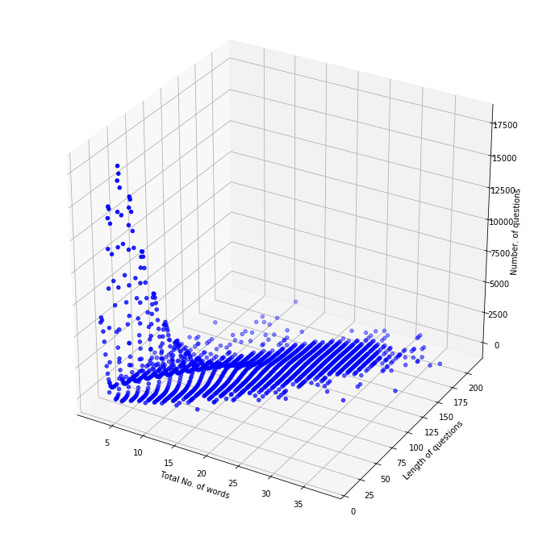
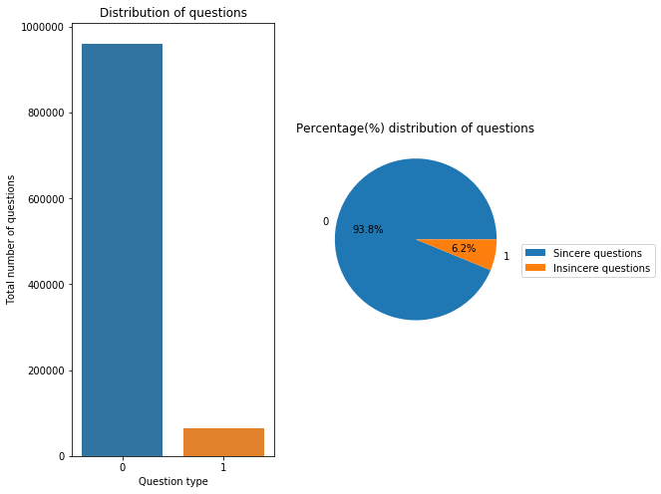
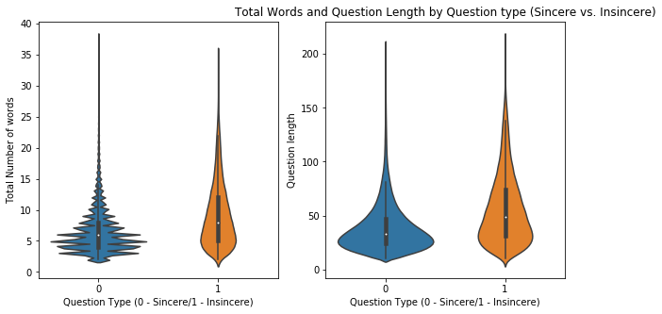
2. Data Exploration (EDA)
https://github.com/shalin4788/Springboard/blob/master/Capstone%20Two/notebooks/2.%20EDA_Quora%20Insincere%20Capstone%20Data.ipynb
Insincere questions have more number of words as well as characters/ question length compared to sincere questions (maybe since they have more junk content..)

Slide 7


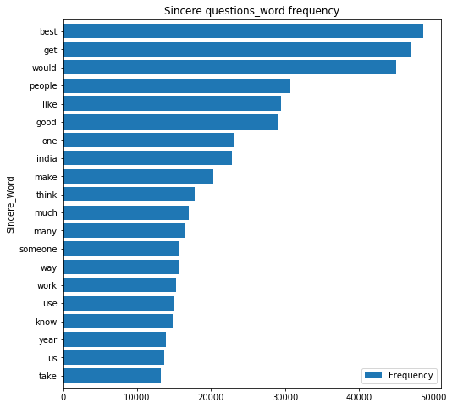
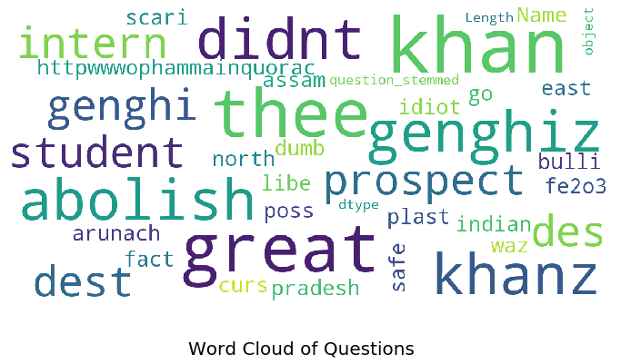
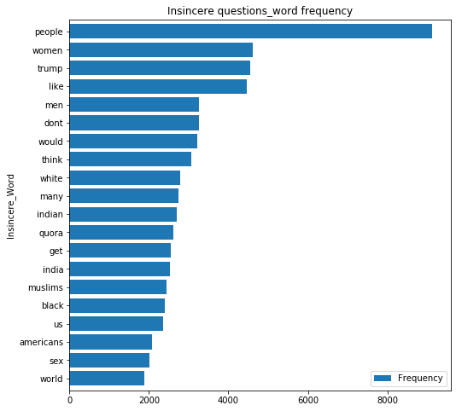


Is there a widespread discrimination and non neutrality in the tone of questions posted on quora?
What is this then? Isn’t this misinformation/ non neutral/ insincere data?

Slide 8







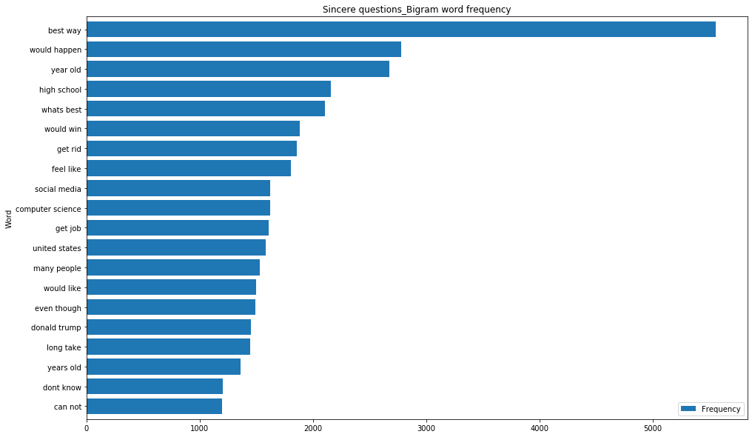
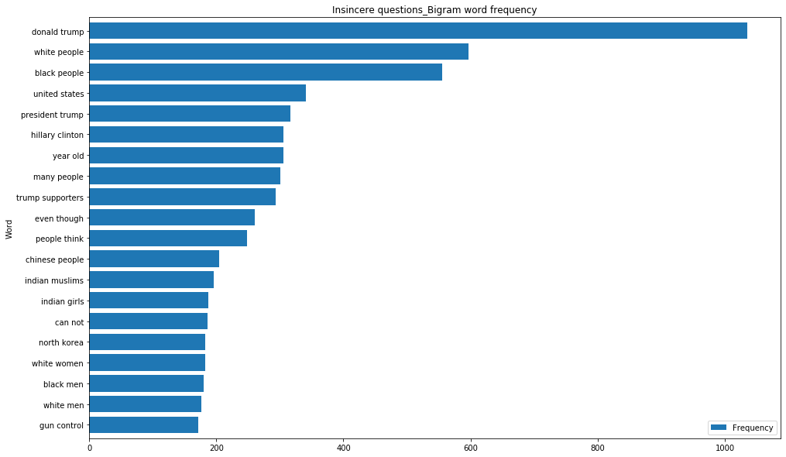
If you were not convinced by what I showed earlier, see these most frequent bigram words….
“No news is bad news”…We just want the limelight…
Folks, ever heard about fake news?
We are here to do policing and punish the misinformation spreaders

Slide 9
3. Feature Engineering
https://github.com/shalin4788/Springboard/blob/master/Capstone%20Two/notebooks/3.%20Preprocessing%20and%20Training%20Data%20Development.ipynb
Cleansed data
Combined dataset: 1024K questions
Data pre-processing
Question text
Dependent Variable
Independent Variable
Target : 1 (Insincere questions, 0: Sincere Questions)
Categorical variable 1
Dependent Variable
Independent Variables (question text’s unigram)
Target : 1 (Insincere questions, 0: Sincere Questions)
Categorical variable 2
Categorical variable 200
….
TFIDF vectorization
Scaling
Data (Training data development)
Training: ~717K questions
Test: ~307K questions

Slide 10
4. Machine Learning Modeling
https://github.com/shalin4788/Springboard/blob/master/Capstone%20Two/notebooks/4.%20Quora%20Insincere%20Classification%20-%20Modeling%20Step.ipynb
Type: Supervised Learning
Models applied
Logistic Regression
Normal
With L2 regularization
Naïve Bayes
K-nearest neighbors (stalled due to high time complexity)
Decision trees
Random Forest
Gradient Boosting
Dependent variable – ‘Target’ (Classified as ‘0’ – Sincere, ‘1’ – Insincere questions)
Independent variables (predictors) – 200 categorical feature (after TFIDF vectorization)
70% Training data
Dataset size:
~717K training dataset, ~307K test dataset
30% Test data
This is a classification problem since we want to weed out insincere questions from sincere questions

Slide 11
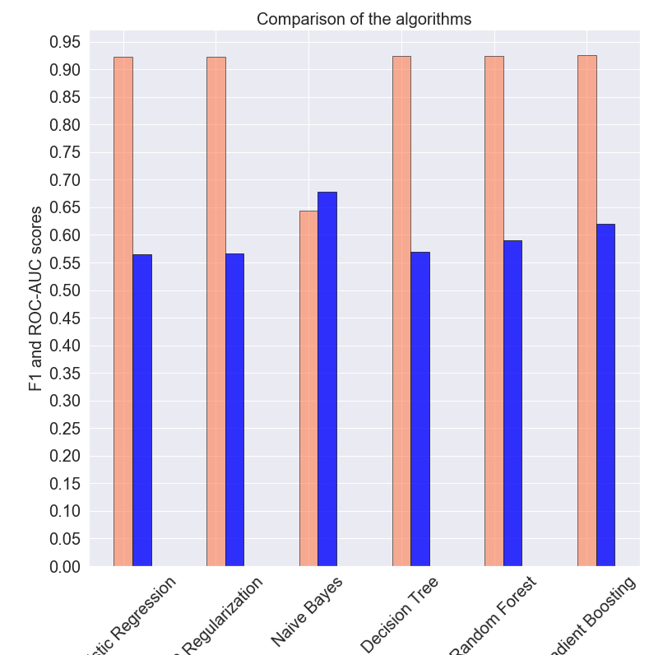
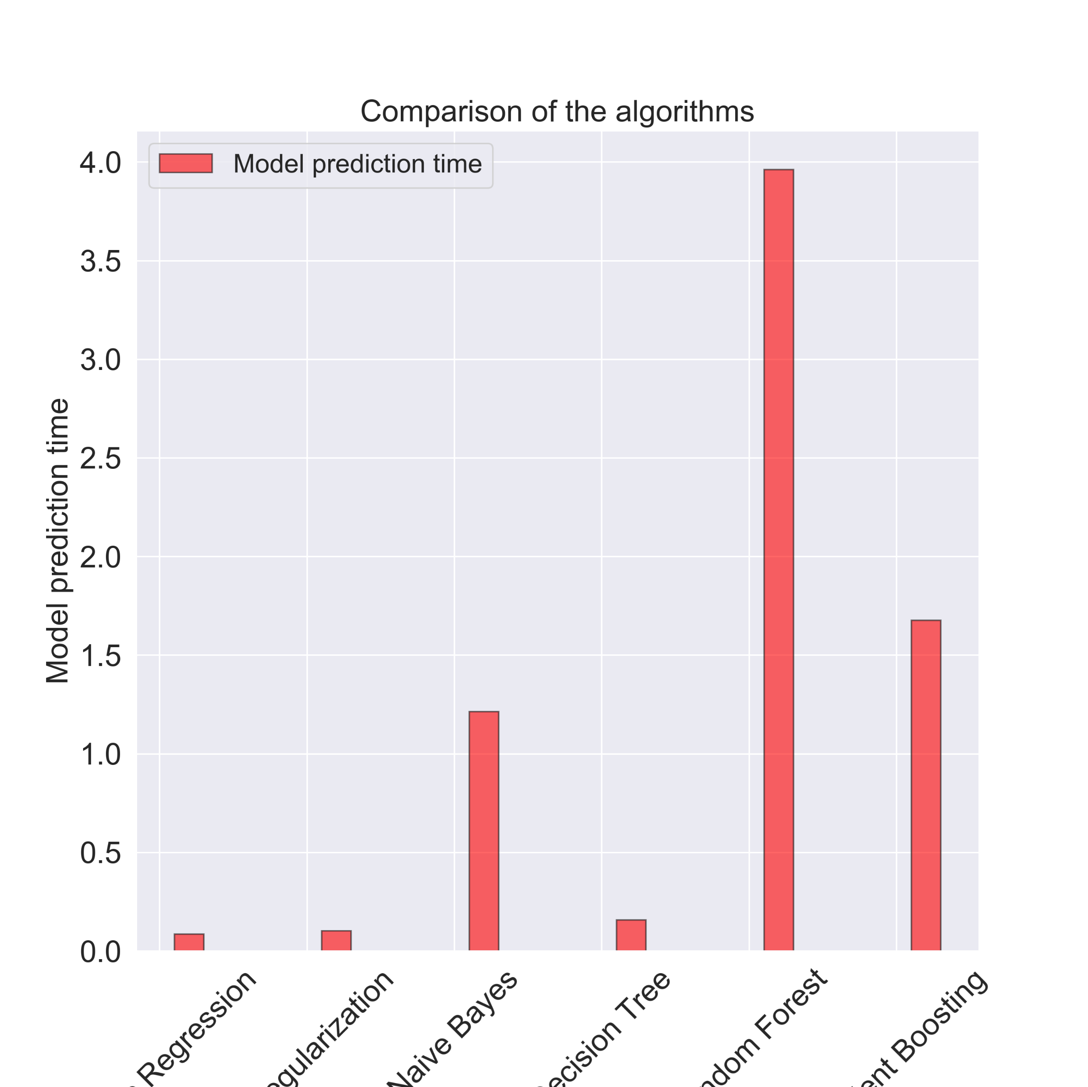
Modeling Comparison
It is important to flag insincere questions and at the same time, not flag sincere questions, hence weighted f1 score is important.
Also, ROC AUC score is important to see how well classifier performed
Slow model prediction..
but can be ignored since it has a high ROC AUC and weighted f1 score

Slide 12
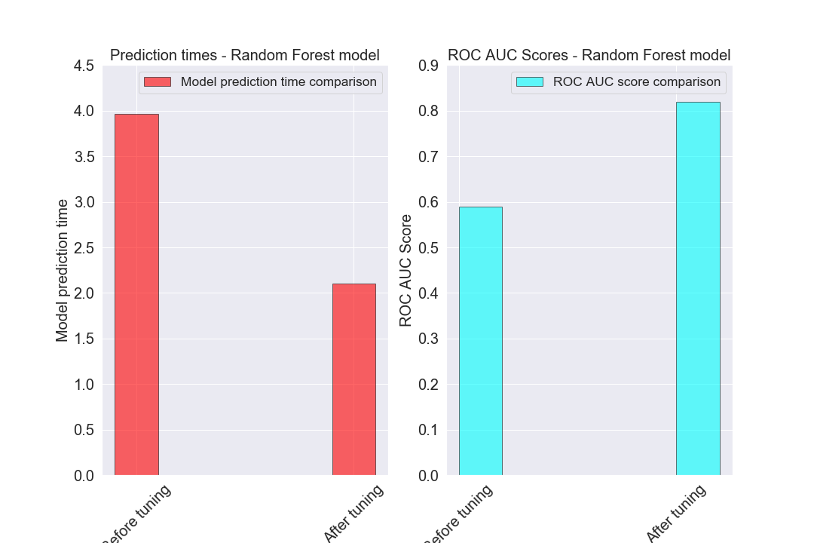

Hyperparameter tuning
In previous slide,
Random Forest and Gradient Boosting had best ROC AUC score and weighted f1score.
Despite higher training time, Random forest model is the chosen model over which Hyperparameter tuning using Grid Search Cross validation is applied and is expected to yield better scores.
Cross validation (CV) for hyperparameter tuning
3 fold cv
Using scikit-learn’s grid search method
Evaluation metrics: ROC AUC score and weighted f1 score
Random Forest classifier model
Random Classifier model using optimal parameters and 70% of training data
Conclusion 1
Random forest was the chosen model. Hyperparameter tuning led to increased returns on both ‘prediction time’ and ROC AUC scores

Slide 13
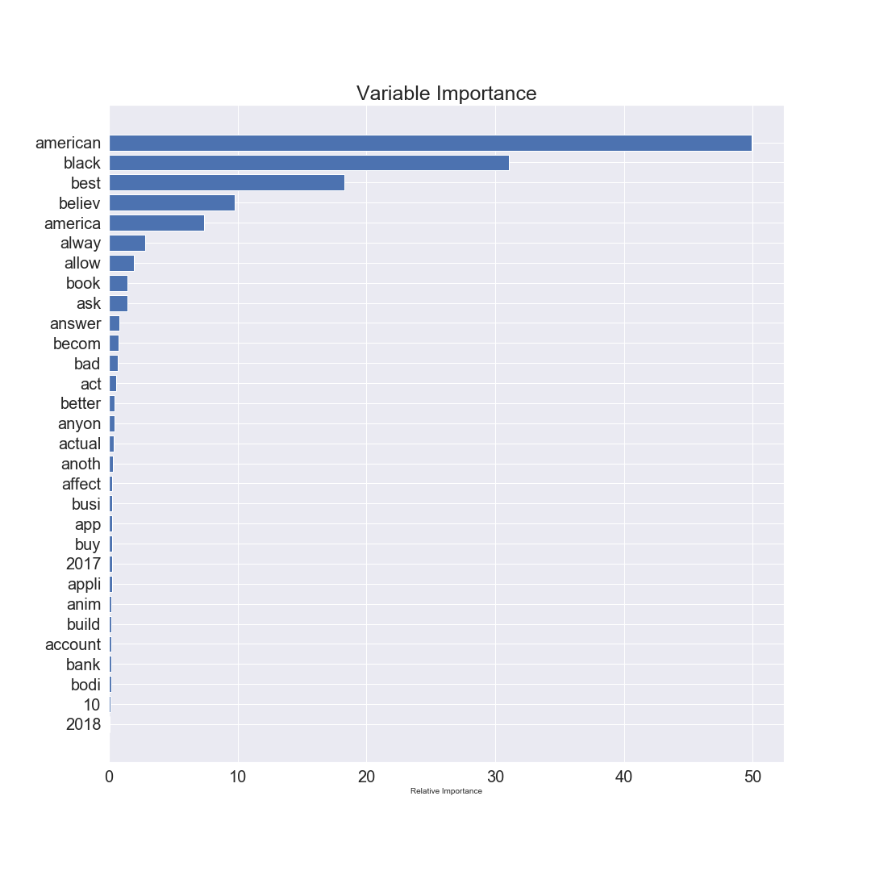
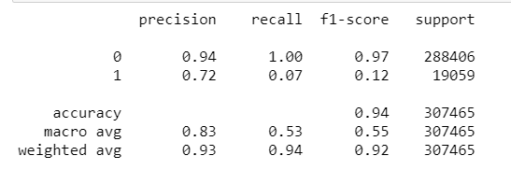
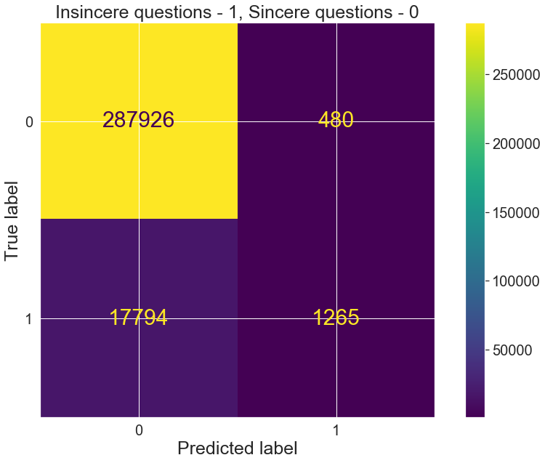
Top features
Unseen Test data: Scores
‘American’ was deemed as feature that had highest positive or negative impact on prediction of data as ‘sincere’ or ‘insincere’
Conclusion 2
On the unseen test data,
There are still a lot of misclassified insincere questions – i.e. false positives (‘1’: Insincere questions) which is the nature of such problems
However, the model was able to predict quite well produce a significantly high true negative rate (‘0’ – Sincere questions) and it is equally important to reduce false negatives for such problems

Slide 14
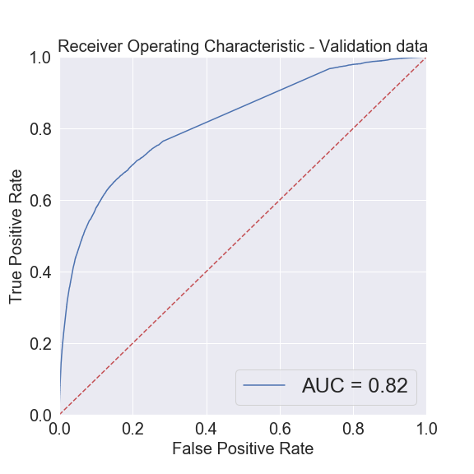
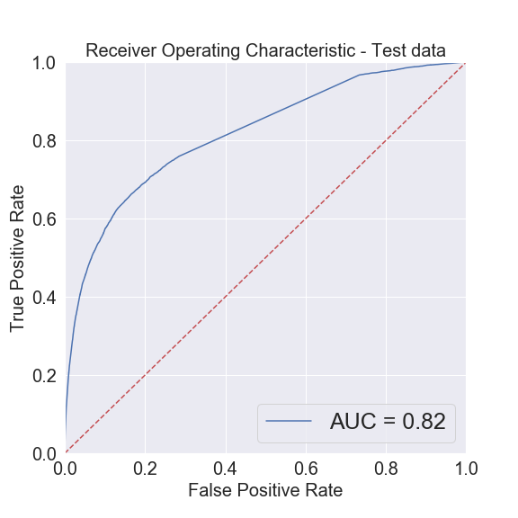
Score comparison – Training (validation) vs Test data
Model fit and predict on validation data
Algorithm: Random Forest classifier model
Hyperparameter tuning using Grid Search Cross validation
Apply saved model to fit and predict on unseen test data
Load model
Save model for future prediction
Training time: 113.45 seconds
Prediction time: 2.098 seconds
ROC AUC score: 0.82
f1 score (weighted): 0.917
Training time is: 218.94 seconds
Prediction time is: 1.677 seconds
ROC AUC score: 0.82
f1 score (weighted): 0.916
Conclusion 3
ROC AUC Score and weighted f1 score was almost the same on the unseen test dataset which is a good sign
The prediction time on unseen test data also fell down to 1.67 seconds compared to 2.1 seconds on validation dataset

Slide 15
Future Research
Apply a different training, test data split instead to further improve scores across different classification evaluation metrics.
Hyperparameter tuning can be performed on Gradient boosting models but limited scope of this project to only tuning Radom Forest classifier model.
Perform hyperparameter tuning on additional parameters than just criterion, max_depth, max_features, n_estimators which could additionally, improve the scores, especially the true positive score
Apply Cross Validation using GridSearchCV across all models rather than just Random Forest that was chosen for Hyperparameter tuning.
Choose more than 200 max features aka categorical features for modeling step.
Chose 200 due to CPU constraints causing overcommit memory issues.
Choosing 500-1000 max features would ensure modeling is performed on a dataset without getting rid of few important features that could have possibly been trimmed in this effort
Use word embeddings to analyze semantic and syntactic similarity, relation with other words for better classification and model results.

